Slide 1
NONPARAMETRIC REGRESSION USING DEEP NEURAL NETWORKS WITH RELU ACTIVATION FUNCTION
Gwangwoo Kim
Jun. 21, 2023

Slide 2
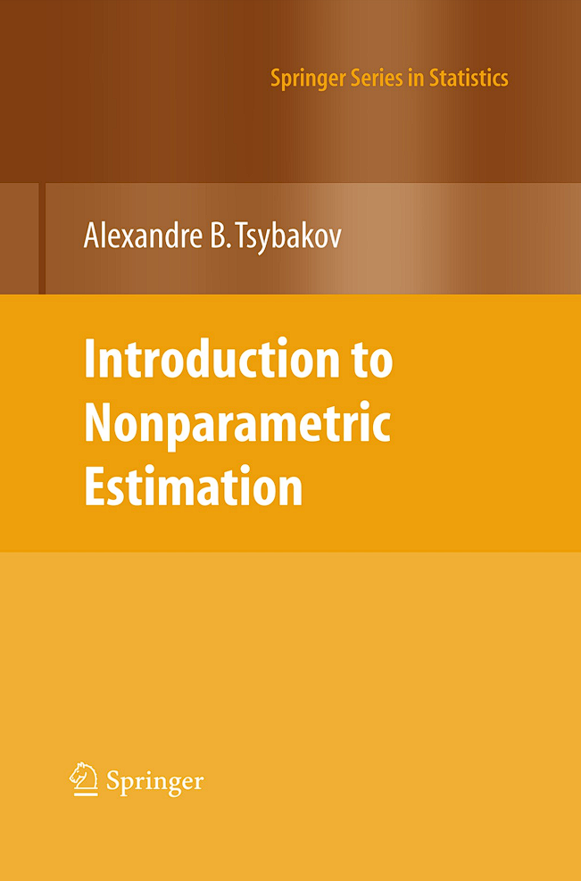

Nonparametric Regression
Nonparametric regression

Slide 3


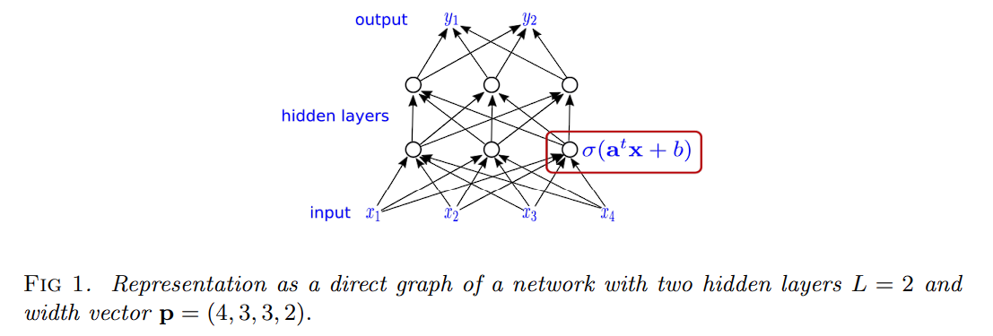
Notation
The ReLU function and its shift:
The network is characterized by (L,p)

Slide 4

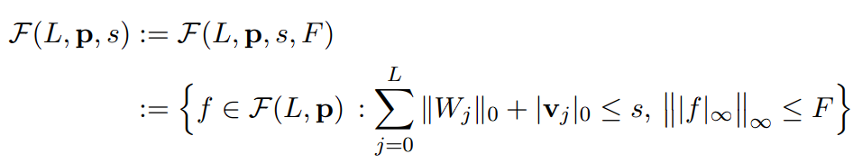
Introduction
A neural network with (L,p) is of the form
The space of network functions:
For sparsity s,

Slide 5
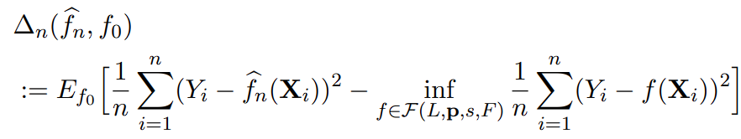

Introduction
Let
The prediction error:

Slide 6


Main Result
Assume
Where
Let t_i be the maximal number of variables on which each of the g depends on
For example,

Slide 7
Holder continuity
Holer continuity:
Holder continuity is used for
Quantifying smoothness
Generalization of continuity
Stability under composition
Connection to other mathematical concepts
Existence and uniqueness of solutions
Approximation and approximation rates

Slide 8
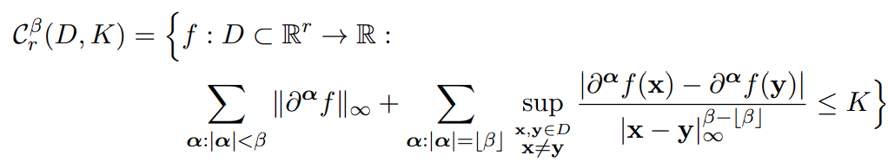
Main Result
The ball of beta-Holder functions with radius K is

Slide 9

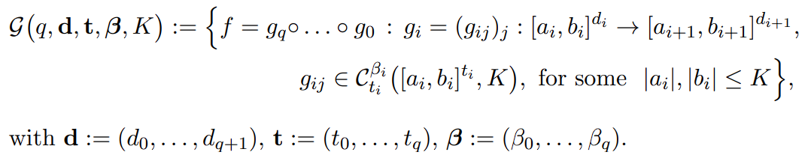
Main Result
Assume
Then the underlying function space is
If and , then f is Holder and has convergence rate

Slide 10
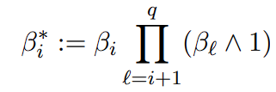

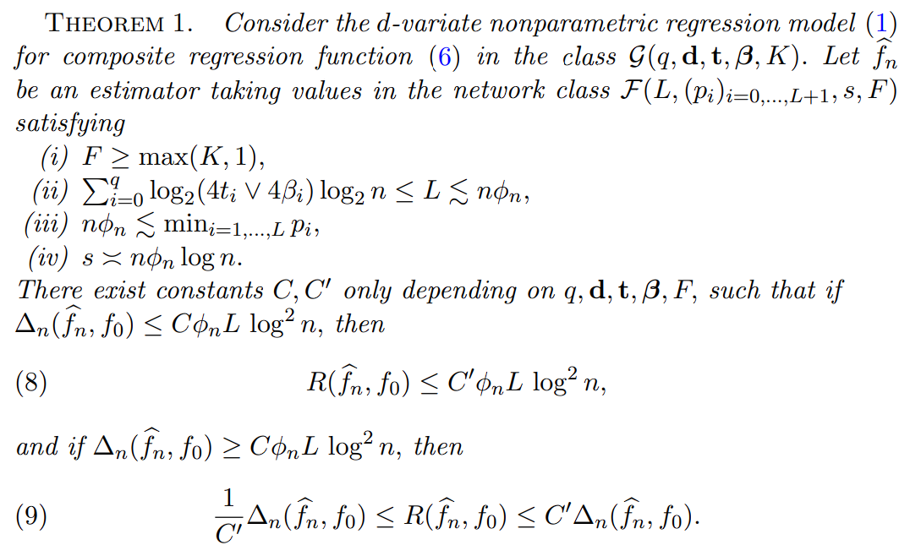
Let and
The best choice is to choose L of the order of ?

Slide 11
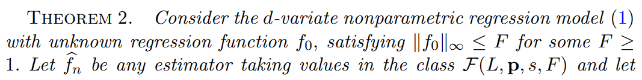
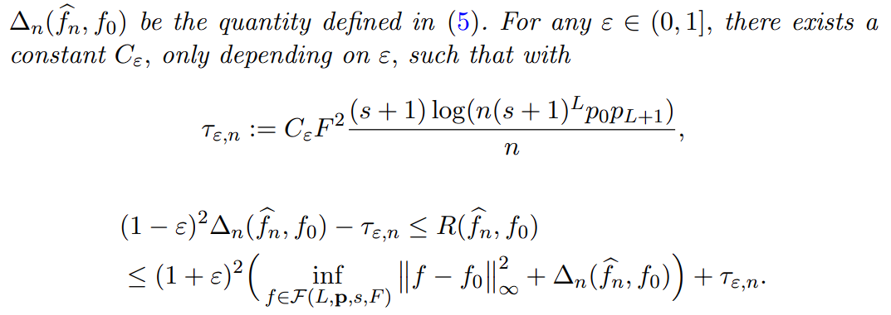
Main Result
The upper bounds on the risk become worse if the number of layers increases
The Residual networks can overcome this problem. But they does not satisfy our assumptions

Slide 12

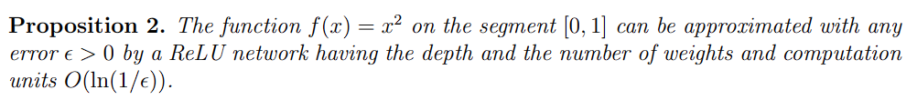
Main Result
Important properties of ReLU:
On the other hand, if all parameters are in a bounded interval, then ReLU function can approximate the square function.
Yarotsky, D. Error bounds for approximations with deep ReLU networks. Neural Networks 94 (2017), 103 – 114.

Slide 13

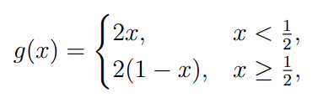

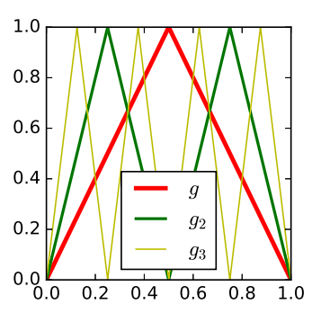
Sketch of proof
Define by

Slide 14

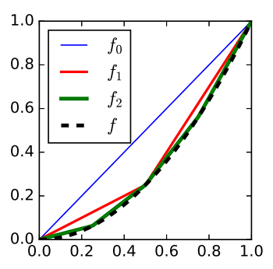
Sketch of proof
Let f_m be the piece-wise linear interpolation of the square function

Slide 15



Sketch of proof
Since , we have
In fact,

Slide 16
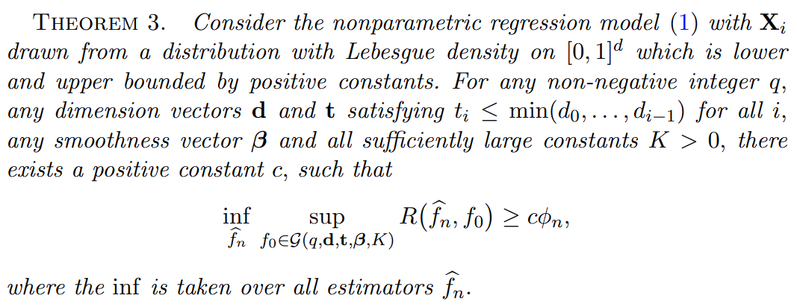
Main Result
This means that no dimensions are added on deeper abstraction levels in the composition of functions.

Slide 17
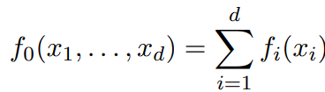





Example: Additive models
Additive Models: and
Where
Suppose further that
Then,

Slide 18
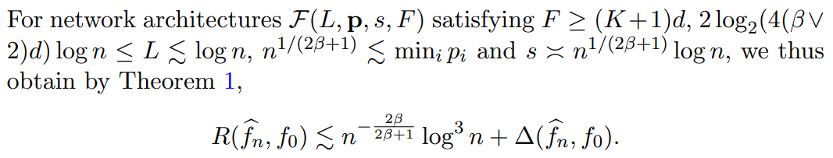
Example: Additive Models

Slide 19
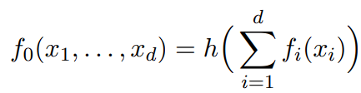



Example: Generalized Additive Models
For
Remark: Theorem 3 shows that is also a lower bound

Slide 20
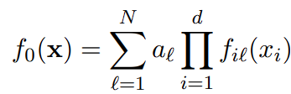








Example: Sparse Tensor Decomposition
Assume
Where
If and , then

Slide 21
Skipped Examples
Wavelet Series Analysis

Slide 22
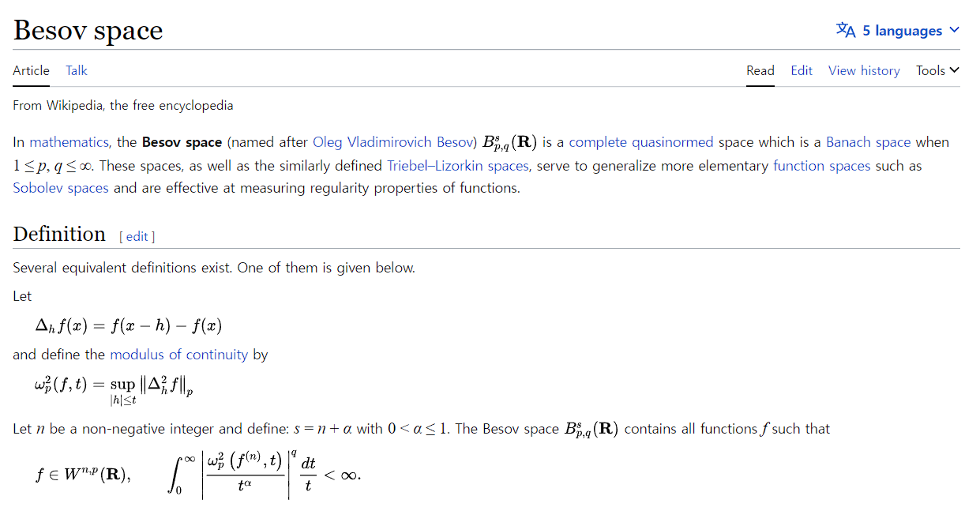
Source: https://en.wikipedia.org/wiki/Besov_space
END

